Slide 1
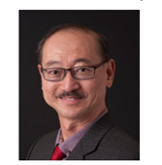
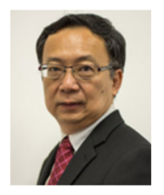
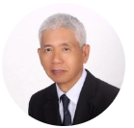
Update on CPD for WSHOs on SDUs for Category 2
SISO members only event
16 February 2024
Chow Choy Wah
Lim Sui Soon
Roger Lim BC
SISO representatives to the CPD Board with MOM & WSHC

Slide 2
Contents
Requirements for Renewal
SDU Categories under Revised SDU Framework
Category 2 – Check for available Accredited courses for 2023
Understanding and check for Valid CPD Code.
Information on your Certificate to submit to MOM’s portal for renewal.
Check and Submit SDUs on MOM’s portal
Self Check on Accredited Courses

Slide 3
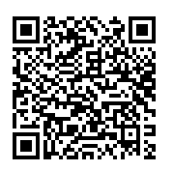
Requirement for WSHO License Renewal
To renew your certification as a WSHO a minimum of 40 SDUs over the renewal-qualifying period ( 2 years)
To submit for renewal at least 60 days prior to the expiry date of their current certificates of registration.
(Please refer to MOM website for the renewal process at: http://www.mom.gov.sg/workplace-safety-health/applications-registrations/competent-person/renew-certificate/Pages/workplace-sho-renewal.aspx#criteria
Note: SDUs obtained under previous SDU framework will still be accepted for your current renewal cycle if the SDUs are obtained within 2 years from registration expiry date.

Slide 4
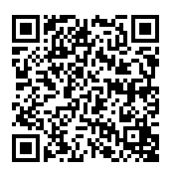
SDU Categories under Revised SDU Framework
Category | Max SDUs per renewal cycle | Description of activities/participation for WSHOs’ renewal | Administrate by Who
Cat 1 - WSH practice | Up to 20 SDUs | WSHO in employment or with WSH roles in the past 2 years, including WSHOs in practice overseas | MOM
Cat 2 - Attended accredited training/activities such as workshops, seminars, conferences, and formal studies | No cap in maximum SDUs | Training accredited by CPD Board include : Conference/events organised by MOM, WSHC and relevant agencies Non-WSH courses that support Continuous Professional Development eg. Soft skills | SISO CPD Board with support from MOM and WSHC
Cat 3 - Other WSH contributions/Attending unaccredited WSH training | Up to 10 SDUs | Contributions Accredited WSH Training Membership Etc. | MOM
Any Enquiries for MOM :
https://service2.mom.gov.sg/efeedback/Forms/eFeedbackWithReferrer.aspx?option=25

Slide 5
Category 1 – WSH Practice
You MUST be directly involved in the workplace WSH activities as part of your appointed/employment role stated in your employment letter/contract agreement.
You MUST be carrying out on-the-ground/on-site WSH role at the workplace.
Appointment to an in-house WSH related committee or team without actual appointment as a WSH Officer will NOT be accepted.
Appointment as a Full-time/Part-Time WSH Trainer conducting only classroom training will NOT be accepted.
SDU Category SDU type Supporting document Approval criteria/condition
Employment Letter
Appointment Letter
Testimonial Letter Must have employment within last 2 years in WSH role on site
Maximum SDUs allowed for Cat 1 is 20.
Category 1 has increased to 20 SDUs to include WSHO duties that including conducting Inhouse courses/trainings and organize safety meetings, WSH events, and inspections etc. No need to submit these evidences.

Slide 6
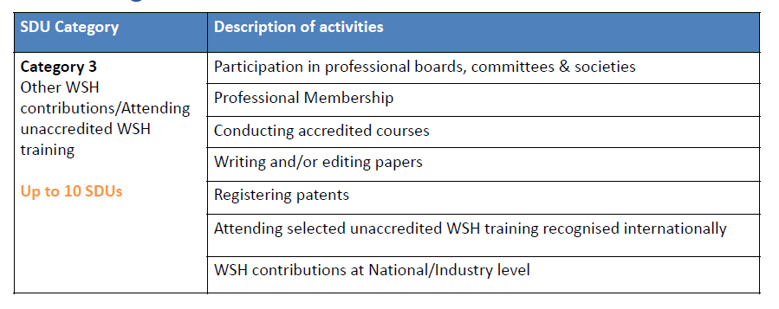
Category 3 – Other WSH contributions/Attending unaccredited WSH training
Category 3 is managed by MOM and evidences are required for all renewal applications.
As SISO Professional member, you can claim 2 SDUs ( valid membership card )
You can only claim SDUs under Category 3 as a trainer if it falls under the WSQ framework; CPD Accredited and WSH related. All other courses and trainings will NOT be accepted. You MUST provide the trainer appointment letter AND latest course timetable from the training provider to claim SDUs.
Attending Unaccredited Internationally recognized WSH Courses & Training that is acceptable to CPD Board.

Slide 7
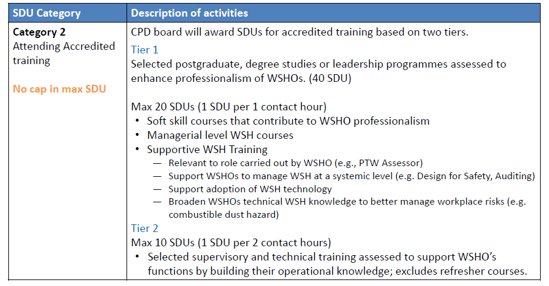
Category 2 – Attending Accredited training/event
Tier 1.1
Tier 1.2
( e.g. Manage Work At Heights)
Tier 2.0

Slide 8
Category 2 – Attending Accredited training/event
Category 2 – Attend Accredited Training by CPD Board No Cap on SDUs For details : log in to https://www.mom.gov.sg/workplace-safety-and-health/wsh-professionals/workplace-safety-and-health-officer/renew-a-registration | Only SDUs approved by the CPD Board with a valid CPD approval code will be accepted. For 2023 & 2024 courses, Check SISO website for training/activities accredited by CPD Board Check or submit SDUs You can log in to check your current SDUs or submit new SDUs. MOM will update their website monthly on Approved courses provided by the CPD Board. Any Accredited courses claimed by Training Provider not found in MOM’s SDUs portal, please check with the training provider. Any issue not resolved by the training provider, submit the feedback to MOM. https://service2.mom.gov.sg/efeedback/Forms/eFeedbackWithReferrer.aspx?option=25 CPD Board only liaise with training providers and MOM to ensure efficient running of the CPD system.
Courses Accredited with SDUs must have CPD Code and SDUs indicated on the certificate. If not, then the course/training is NOT accredited for SDUs.

Slide 9
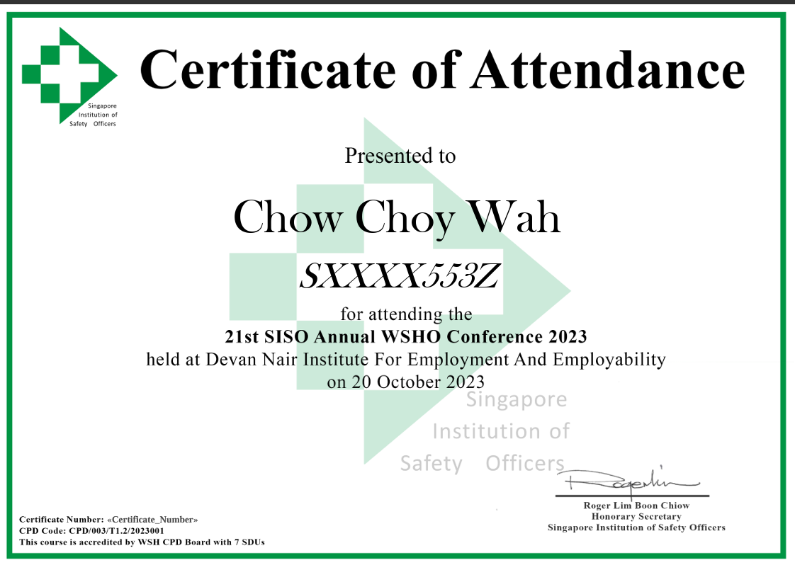
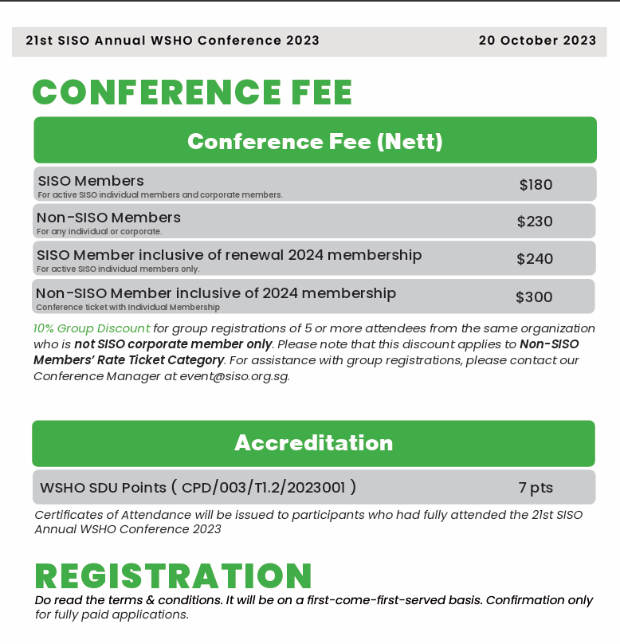
Check these on the Brochure and Certificate
Brochure
Organiser : Singapore Institution of Safety Officers ( CDP/003/……)
Certificate
CPD Code
If you have attended this SISO conference and did not receive your certificate, please email admin@siso.org.sg ( subject : SISO Conference 2023 Certificate )

Slide 10
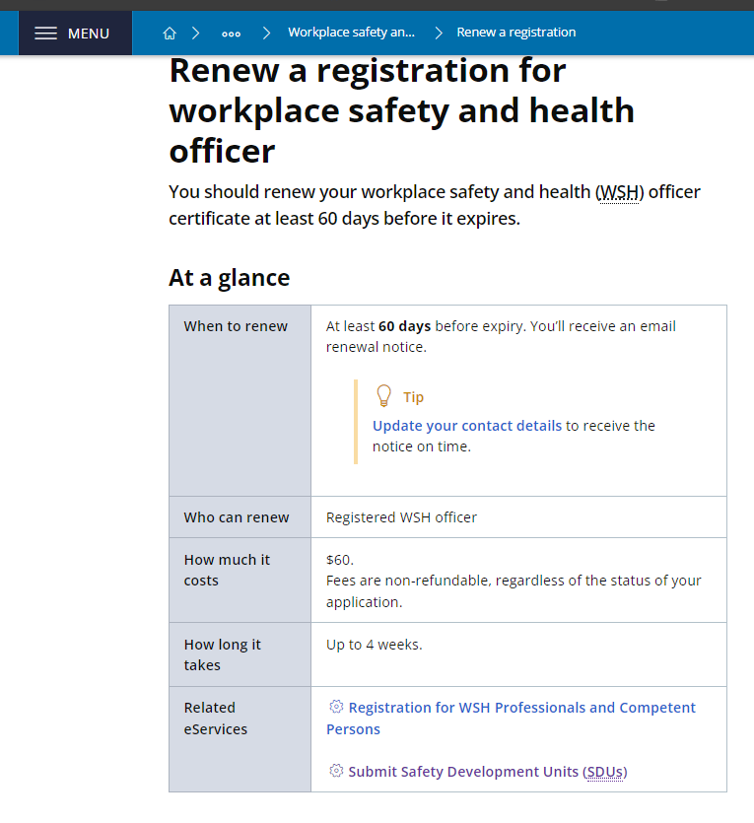
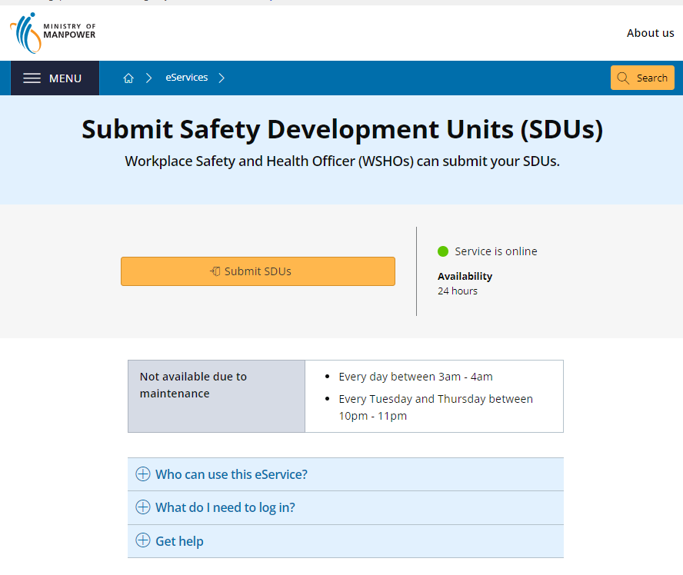
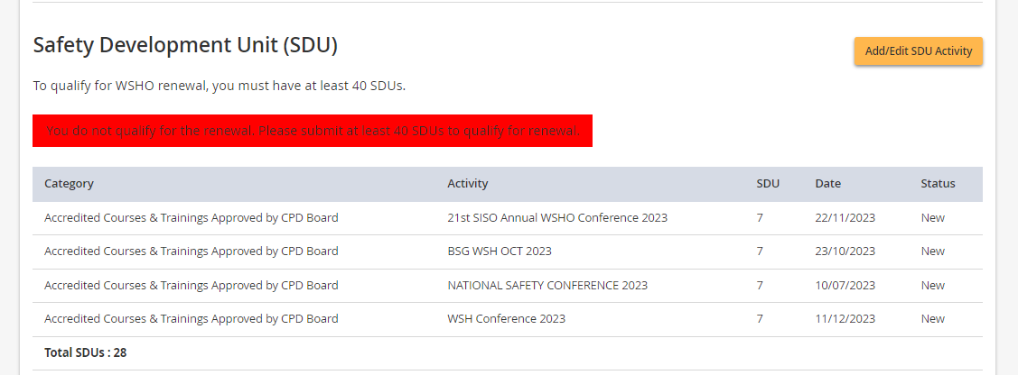
Each time, you receive your certificate, please log in MOM portal
https://www.mom.gov.sg/workplace-safety-and-health/wsh-professionals/workplace-safety-and-health-officer/renew-a-registration

Slide 11
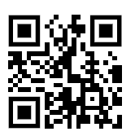
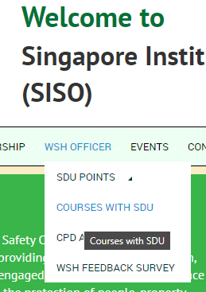
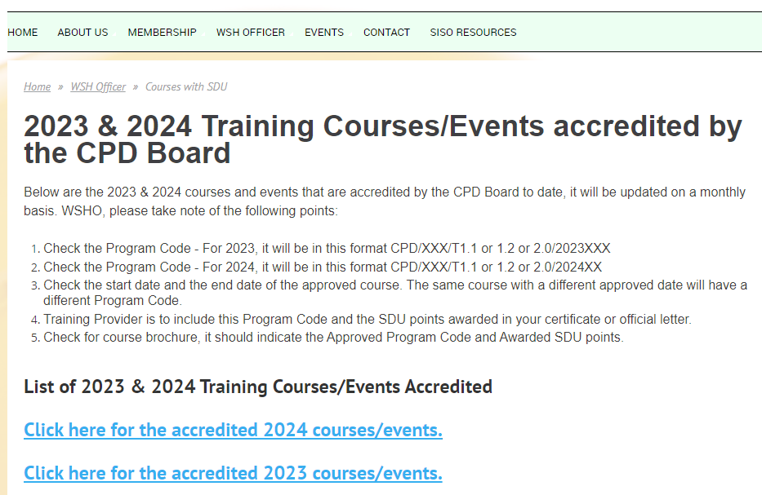
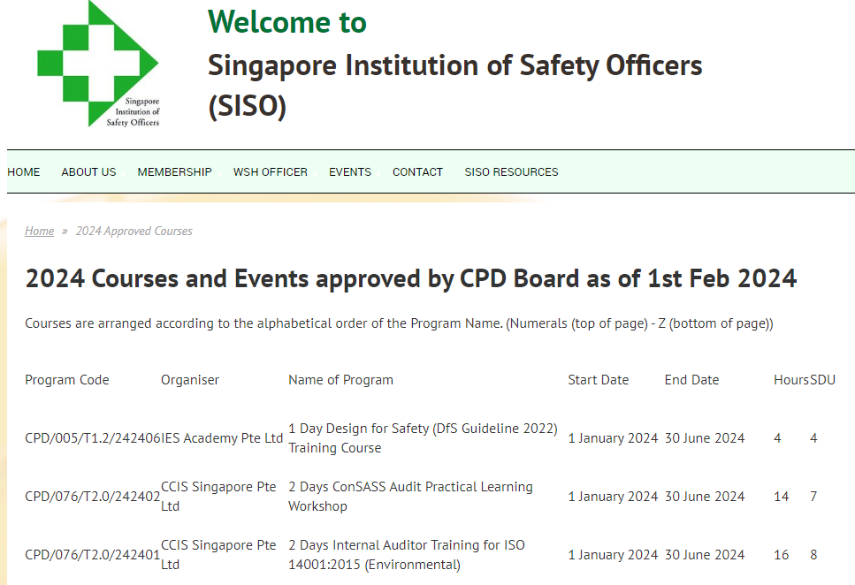
Category 2 – Check for Accredited courses
Check SDUs Courses from SISO website.
Singapore Institution of Safety Officers - Home (siso.org.sg)
To Look for 2024 Approved Courses with SDUs , log into this website to check ( ensure course is within the Valid Dates )

Slide 12
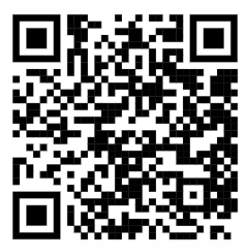
Key information on the CPD Code
T1.2 - Category 2 – Tier 1 course - 1 SDU for every 1 hour, each course capped at 20 SDUs
T2.0 - Category 2 – Tier 2 course - 1 SDU for every 2 hours, each course capped at 10 SDUs
242403 - Refer to course starts in 2024 and end in 2024 and 003 refers to running number on the courses by this TP in 2024
Name of Program - ISO 22301:2019 Business Continuity Management Systems Internal Auditor – Please check the certificate must match this title and also CPD Code – CPD/252/T2.0/242403
https://www.siso.edu.sg/courses

Slide 13
Your Certificate must have the following information
Name of the learner or event participant (for example: Tan Ah Biao)
NRIC or FIN ( for example: Sxxxx123A)
Course or Event title (as indicated on brochure / Training provider’s application)
Course or Event date(s) (within the granted accreditation window eg. Jan to Jun 2023)
18th June 2023 ( one-day course )
1st March 2023 to 30th May 2023 ( for a course with 3 months duration)
Identity of training provider or event organiser (for example: ABC Training Pte Ltd)
CPD code (as granted by CPD Board) eg. CPD Code – CPD/241/T1.2/2023008
SDU statement (for example: This course is accredited by WSH CPD Board with 14 SDUs)
In the case of SOA which are issued by SSG, which may not have the highlighted CPD accreditation information printed on the statement of achievement, TP are required to issue a Letter of Certification complete with the highlighted CPD accreditation information clearly printed on the letter as a supporting document to enable MOM to authenticate the CPD code and SDU points granted to the course/event accredited by CPD Board.
Failure to furnish any of the above course/event details particularly the highlighted CPD accreditation statement may hinder the successful submission of SDUs to MOM by WSHO in renewing their license.

Slide 14
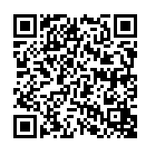
What you may want to do ….
Before Attending courses
For SDUs, attend courses that the TP has indicated on their brochure the Approved CPD Code.
You can verify if it is valid via SISO website. ( it is updated monthly on the 1st week of the following month)
Check that the CPD Code is still valid for the period issued ( 1Jan 2024 to 30 Jun 2024) for your course.
If it not listed, check with the Training Provider or choose another Training Provider or another course.
After Attending courses
Check that your certificate has all the required information as required by CPD Board & MOM.
Submit your SDUs into MOM’s portal asap ( don’t wait until last minute )
If any issue, check with the Training Provider to resolve.
If Training Provider unable to resolve your problem, submit feedback to MOM as below. https://service2.mom.gov.sg/efeedback/Forms/eFeedbackWithReferrer.aspx?option=25
Note that MOM will check the certificate submitted by you to authenticate the CPD code and SDU points granted to the course/event accredited by CPD Board to verify that it is valid. It is WSHO responsibility to ensure correct certificate submitted.

Slide 15
Q&A
Q1 - Regarding WSHO renewal, is the 20 SDU points to claim as an employed WSHO be just certified with an employer letter or need an employment letter.
Ans : Yes.
Q2 - What are some ways to ensure that safety officers are supported in renewing their certificates? There are only so many courses for safety officers to take.
Suggested Ans : There are Category 1, 2,3 to clock your SDUs.
Please refer to the website to see the available courses with accredited SDUs.
Q3 - What should I do if my course/module certificate does not indicate the CPD Code and SDUs awarded?
Ans :Please contact the training provider to reissue the certificate with the CPD Code and SDUs awarded. Only CPD Approved courses will be given CPD Code and SDUs.

Slide 16
Q&A
Q4 - Why some of the SDUs or courses I submitted have disappeared from my eService screen?
Ans :Only Accepted SDUs after processing will be displayed on your eService screen. Rejected SDUs will be removed. SDUs will be rejected when:
Wrong supporting documents are submitted for SDUs.
Duplicate SDUs are submitted for the same item.
SDUs are submitted under wrong category.
Course title and training provider name stated on the final certificate DO NOT match the selected SDU item.
Accredited courses/events not conducted within accreditation window will not be awarded SDU
If you are unable to find the course in the SDUs list, please contact your training provider for assistance

Slide 17
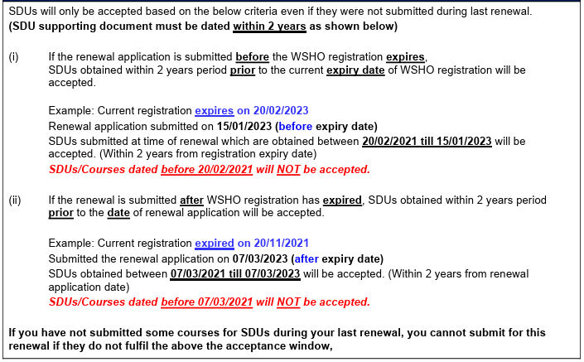
How are the SDUs calculated, evaluated and accepted for renewal?

Slide 18
Thank You
Email : cpd@siso.org.sg
Updated 26 March 2024

